Slide 1




> your credentials were leaked
YOUR CREDENTIALS
WERE LEAKED.
So what?
lure
→
steal
→
abuse
PhishTrack // Your credentials were leaked, so what?
Xavier Mertens (@xme) · Pascal Kahn
01
Notes:
[SOLO] Cold open. 'Your credentials were leaked.' Beat. 'So what?' That shrug is the whole talk: not IF you leak, but what happens in the minutes after. Xavier co-authored this; he's running SANS training in Singapore, so I'm solo today.

Slide 2

> whoami && whoami --the-other-one
The two of us (one of us is in Singapore)
Xavier Mertens
Pascal Kahn
@xme
@teqagogo
Freelance security consultant & incident handler.
SANS Internet Storm Center handler; trainer & speaker.
Runs the blog /dev/random and a personal MalwareLab.
Co-author of PhishTrack — the brains on threat-intel & detection.
Builder of the PhishTrack platform.
SOC and offensive/defensive tools dev
Drives the engineering: analyzer, honeypots, canary engine.
Flying solo today; Xavier sends his regards from 11,000 km away.
PhishTrack // Your credentials were leaked, so what?
Pass the Salt 2026 · TLP:CLEAR
02
Notes:
[SOLO] Lampshade the solo thing early — it's disarming and buys goodwill. EDIT Pascal's real bio bullets before the talk. If Xavier joins for BSides Amsterdam, this slide already supports two; split Part 1 (tool) / Part 2 (findings).

Slide 3
> so your creds leak. so what?
Everybody gets phished. Three questions.
Q1
Q2
Q3
Do they even
get used?
How FAST?
From where?
we stopped guessing and built a machine that measures all three.
PhishTrack // Your credentials were leaked, so what?
Pass the Salt 2026 · TLP:CLEAR
03
Notes:
[SOLO] Everybody in this room is in a dump somewhere — phishing is weather, not an event. So the defensive question is lost. The good question is three: do leaked creds get USED, how FAST, and from WHERE. These are the spine; Part 2 answers all three with data.

Slide 4
> the idea
Stop defending.
Start baiting.
we submit credentials we own to the phishing page…
CANARY GAMBIT
…then watch who comes to use them.
classic honeypots wait to be found — we plant the bait ourselves.
PhishTrack // Your credentials were leaked, so what?
Pass the Salt 2026 · TLP:CLEAR
04
Notes:
[SOLO] The 'aha'. Classic honeypots wait. We do the opposite — we go find live phishing pages and feed them credentials WE own and that are worth nothing to anyone but us. Then we watch who turns up to use them. The canary gambit. Unique per URL, so a hit is unambiguous attribution.

Slide 5
> current record
16 SECONDS
from credential planted → first abuse on our honeypot
Source: Sri Lanka. Faster than your SOC pours its first coffee.
PhishTrack // Your credentials were leaked, so what?
Pass the Salt 2026 · the hook
05
Notes:
[SOLO] The hook. Let it punch in, then SHUT UP for two seconds. Our record from planting a fake credential on a phishing page to the first abuse on our trap: SIXTEEN SECONDS. Source: Sri Lanka. That's faster than your SOC pours its first coffee. (Note: the OLD story was '3 minutes / Nigeria' — the data says 16 s / Sri Lanka for speed; Nigeria leads on VOLUME. Use the real one.)

Slide 6







> docker compose ps # 11 services · 4 jobs
One machine: collect · bait · trap · measure
PHISH PAGE
ANALYZER
ML ENSEMBLE
ALERTS
ATTACKER
SQLITE CORE
COMMAND UI
EDGE
HONEYPOTS
FINGERPRINTS
CANARY VAULT
URL in → attacker intelligence out · air-gapped: never phones home
PhishTrack // Your credentials were leaked, so what?
Pass the Salt 2026 · TLP:CLEAR
06
Notes:
[SOLO] Don't read it; let it build in 5 stages following the data flow. URL in at the phish page; the analyzer opens it; two ML brains score it; the canary vault loops a fake cred back into the form; the attacker hits edge→honeypots→fingerprints; everything fans out to alerts + UI. Eleven services, four jobs: COLLECT, BAIT, TRAP, MEASURE. Air-gapped — the analyzer VM never phones home. Deep how-it-works is in the technical deck.

Slide 7
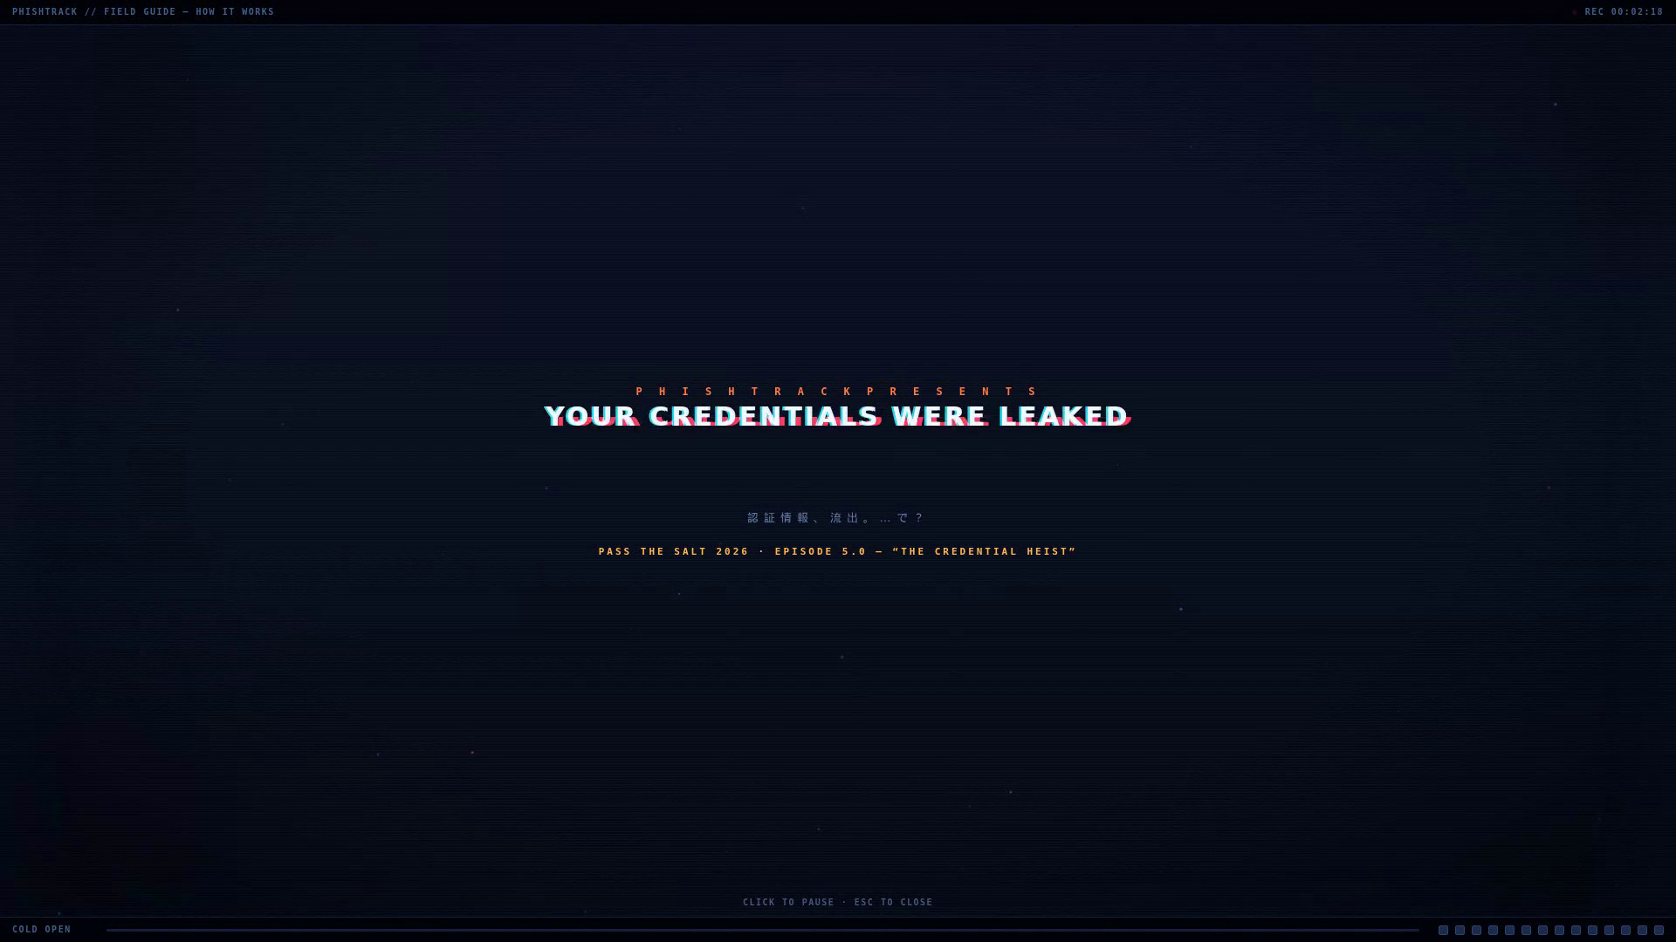
> play animation
PhishTrack // Your credentials were leaked, so what?
Pass the Salt 2026 · TLP:CLEAR
06
Notes:
[SOLO] Don't read it; let it build in 5 stages following the data flow. URL in at the phish page; the analyzer opens it; two ML brains score it; the canary vault loops a fake cred back into the form; the attacker hits edge→honeypots→fingerprints; everything fans out to alerts + UI. Eleven services, four jobs: COLLECT, BAIT, TRAP, MEASURE. Air-gapped — the analyzer VM never phones home. Deep how-it-works is in the technical deck.

Slide 8
> [bait] canary-identities --unique-per-url
Meet Margaux. She isn't real.
~1.9M
83,775
1 / URL
identities in the pool
canaries planted (3 months)
a hit names its source
most honeypots tell you THAT you were attacked.
The canary gambit tells you WHICH page sold you out — by name.
UNAMBIGUOUS ATTRIBUTION
PhishTrack // Your credentials were leaked, so what?
PILLAR · BAIT
07
Notes:
[SOLO][FLAGSHIP] The bait is a believable fake person — name, email, password — UNIQUE per phishing URL, from a pool of ~1.9M identities. We planted 83,775 of them on live phishing pages over three months. When 'Margaux' shows up on our honeypot, attribution is unambiguous: nobody else on earth was given her. Most honeypots say THAT you were hit; this says WHICH page sold you out.

Slide 9
> [score] ensemble --calibrated --explainable
Is this URL evil? Ask the committee.
LightGBM
char-TCN
Transformer
HTML model
→
META-COMBINER
URL lexical
char sequence
token context
rendered DOM
calibrated score + SHAP
~94%
~0%
19 ms
detection (held-out)
false positives
per URL, end-to-end
shadow → assist → primary promotion · full training pipeline in the technical deck.
PhishTrack // Your credentials were leaked, so what?
PILLAR · SCORE
08
Notes:
[SOLO] Before we trust a URL is phishing, a committee votes. Four small models — gradient-boosted trees on the URL text (LightGBM), a character-level temporal CNN, a distilled transformer, and a model that reads the rendered HTML — and a fifth calibrated referee fuses them and explains itself with SHAP. ~94% detection at ~0% false positives, 19 ms per URL. FULL training process + architecture is in the technical deep-dive deck.

Slide 10
> ensemble.predict(url, dom) → calibrated_score
Detection engine: a committee with a calibrated referee
LightGBM
clean < 0.15
URL string
URL lexical GBDT
lexical / structural
META-COMBINER
suspect 0.4–0.7
char-TCN
char-seq conv net
rendered DOM
calibrated · LGB-dominant
phishing > 0.7
distilled TFM
forms · brand · text
token context (ONNX)
+ SHAP why
HTML model
DOM / form signals
escalate-only adjudication: the calibrated score can raise a verdict; a confidently-benign LightGBM URL score can clear noise. heuristics still run underneath.
PhishTrack // Your credentials were leaked, so what?
detection engine
09
Notes:
The detection brain. Two raw inputs — the URL string and the rendered HTML/DOM — fan into four base learners. Each emits a phishiness probability; a calibrated meta-combiner (LightGBM-dominant) fuses them into one score, mapped to clean/suspect/phishing bands, with SHAP attributions for every verdict. This is an ensemble-of-experts with a learned, calibrated referee — not a single black box.

Slide 11
> train.py # the ML training pipeline
ML training pipeline
LABELS
heuristic-confirmed + canary ground-truth + ml_feedback
FEATURES
same extractor as inference → zero train/serve skew
BASE MODELS
train LightGBM · char-TCN · TFM · HTML independently
STACK
meta-combiner trains on out-of-fold base predictions
CALIBRATE
isotonic/Platt on held-out → score ≈ probability
EVAL
precision/recall/FP · latency · vs current primary
The canary signal is the secret weapon: a planted credential that gets abused proves its origin URL was phishing — free, high-confidence labels with no analyst time.
PhishTrack // Your credentials were leaked, so what?
ML training
10
Notes:
How the models are trained. Ground truth comes from three places: heuristic-confirmed phishing, the canary signal (a URL that later abused a planted credential is phishing, with certainty), and human ml_feedback. Features are extracted with the SAME code path used at inference (no train/serve skew). Each base model trains independently; the meta-combiner trains on their out-of-fold predictions; then calibration on a held-out split; then offline eval before any promotion.

Slide 12
> promote: shadow → assist → primary (auto-demote)
Staged promotion — models earn trust
D
SHADOW
B
ASSIST
A
PRIMARY
ML computed alongside
NEVER touches the verdict
pure measurement / backtest
advises only; records ml_band
flags confident disagreements
ML won ~71% of those in report
calibrated score adjudicates
escalate-only, heuristics floor
watchdog auto-demotes on regress
A model is only as trusted as its last precision check — promotion is reversible, automatically.
PhishTrack // Your credentials were leaked, so what?
ML training
11
Notes:
The safety system around the model. A new model never just 'goes live'. It runs in SHADOW (computed, recorded, never touches the verdict), then ASSIST (advises and flags rows where it confidently disagrees with heuristics — the calibration report showed ML wins ~71% of those), then PRIMARY (the calibrated score adjudicates, escalate-only). A watchdog continuously checks precision and AUTO-DEMOTES on regression. This is D→B→A staged promotion.

Slide 13
> [trap] listen 443,22,3389,5900,3306
They land on our turf.
every header · cookie · JA3 · keystroke — logged, enriched, attributed.
/owa
M365
/citrix
GlobalProtect
SSH:22
RDP:3389
VNC:5900
MySQL:3306
they think they're logging into your VPN.
GOTCHA
They're filling out our incident report.
+ deception: stateful fake shells & prompt-injection tripwires for AI scanners (technical deck).
PhishTrack // Your credentials were leaked, so what?
PILLAR · TRAP
12
Notes:
[SOLO][FLAGSHIP] When the crook tries the stolen keys, they land on OUR fake portals — and we also run real protocol honeypots on the classic ports. Every header, cookie, JA3 fingerprint and keystroke is logged: full request, half-meg body, stored instantly, enriched async with geo/ASN/reputation. They think they're logging into your VPN; they're filling out our incident report.

Slide 14
> honeypot.py # capture engine
Honeypot capture engine
web credential portals
raw protocol honeypots
/owa
M365
/citrix
GlobalProtect
SSH:22
RDP:3389
VNC:5900
MySQL:3306
/saml
autodiscover
/ecp
prelogin.esp is the #1 probe path; portals emit realistic product fingerprints (PAN-OS / NetScaler / Exchange build strings).
real listeners on classic ports → mostly scan recon (the ~6 M noise rows); credential-linked TTA happens on the portals.
captured on every hit
full headers
≤512 KB body
cookies
TLS JA3
source IP
keystrokes
→ enrich async: GeoIP · ASN · Tor · AbuseIPDB · VirusTotal
PhishTrack // Your credentials were leaked, so what?
honeypot
13
Notes:
The trap. Credential-capture portals (OWA, M365, Citrix, GlobalProtect prelogin.esp, SAML, Exchange autodiscover/ECP) PLUS real protocol honeypots on the classic ports. On any hit we capture the full request — headers, up to 512 KB body, cookies, TLS JA3, source IP — store immediately, enrich async (GeoIP/ASN/Tor/AbuseIPDB/VT). TTA exists only here, because a hit links back to the exact planted canary via url_id.

Slide 15
> deception.py · deception_responder.py
Deception & anti-AI tripwires
ProductFingerprint
Stateful fake shell
Realistic NetScaler / PAN-OS / Exchange build strings.
Some CVE-flagged → looks exploitable.
Draws scanners deeper, on our terms.
Answers commands, fake /etc/passwd, fake users/tables.
State lives OUTSIDE any LLM — can't be prompt-talked out.
Burns attacker (and bot) time.
LLM tripwires
Bot scoring
Prompt-injection planted for AI-driven scanners.
The instructions on the page are ours.
Catches autonomous-agent recon.
browser_fingerprints.bot_probability.
~20 weighted signals: webdriver_true −0.40, headless UA −0.35, CDP, swiftshader…
Separates humans from automation.
PhishTrack // Your credentials were leaked, so what?
deception
14
Notes:
Beyond logging — we waste attacker time and trap their tools. ProductFingerprint emits believable vulnerable build strings (incl. CVE-flagged versions) so scanners think they found a real target. A stateful fake shell answers commands and serves fake /etc/passwd — and its state lives OUTSIDE any LLM, so an AI-driven attacker can't talk it out of character. LLMProbe plants prompt-injection tripwires for AI scanners. The browser_fingerprints bot model scores automation from ~20 weighted signals.

Slide 16
> evasion.py · fingerprint_processor.py
Evasion (outbound) & Fingerprinting (inbound)
Fetch like a victim (outbound)
Fingerprint the attacker (inbound)
Playwright-stealth headless; AutomationControlled disabled.
JA3/JA4 TLS impersonation via curl_cffi — handshake matches a real browser.
Residential proxy egress; per-URL context isolation.
Cloudflare / CAPTCHA handling; cloaking detection (scanner-page vs victim-page).
Goal: become unremarkable to the kit's anti-analysis.
HASSH — SSH client fingerprint (key-exchange params).
JA3 / JA4 — TLS client fingerprints.
HTTP header ORDER — tooling tell.
attacker_profiles aggregates per source IP: hassh_set, threat_score_max.
Campaign clustering: token edit-distance + K-means → one operator, many IPs.
PhishTrack // Your credentials were leaked, so what?
evasion / profiling
15
Notes:
To reach attacker infra we must not look like a scanner; to attribute attackers we fingerprint their tooling. Fetch: Playwright-stealth + JA3/JA4 TLS impersonation via curl_cffi, residential proxies, Cloudflare/CAPTCHA handling, cloaking detection. Profiling: HASSH (SSH), JA3/JA4 (TLS), header order — attackers rotate IPs but not their stack, so we cluster 'same operator, many IPs' with token edit-distance + K-means.

Slide 17
> exploit_capture.py · exploit_responder.py
Exploit capture & kill-chain linking
A
B
C
linked per session_id → one story
probe for RCE
GET the payload
exfil / stage-2
signatures + zero-day catch
captured_payloads (YARA)
26 signatures: SQLi · XSS · LFI · CMDi · SSRF · XXE · Log4Shell…
Shannon entropy on POST bodies = best zero-day signal.
No signature match? Preserve raw bytes + flag analyst — never drop.
Token-grade exfil (bot tokens, webhook IDs) = near-zero-FP catch.
3,875 captured
0 executables
918 scripts
entropy 5.25
YARA on every captured file.
Scripts dropped, no compiled malware in window.
entropy + magic-type + sha256 stored per payload.
PhishTrack // Your credentials were leaked, so what?
capture
16
Notes:
When attackers go past login, we keep the evidence. exploit_capture links stage-2 fetches A→B→C per session into one kill-chain. 26 exploit signatures (SQLi, XSS, LFI, CMDi, SSRF, XXE, Log4Shell…). The zero-day catch: Shannon entropy on POST bodies — a high-entropy/base64 body we have no signature for is preserved as raw bytes and flagged, instead of dropped. YARA runs on captured_payloads: 3,875 captured, 0 executables, 918 scripts, mean entropy 5.25.

Slide 18

> [measure] time-to-abuse
Time-to-Abuse: the only clock that matters.
The gap between 'credential leaked' and 'credential used.' smaller = scarier = automation.
your password-rotation policy: every 90 days.
Their credential-reuse time: seconds.
00:16
per-canary
instant
fastest TTA observed
capture→abuse timestamps
alert on first touch
PhishTrack // Your credentials were leaked, so what?
PILLAR · MEASURE
17
Notes:
[SOLO][FLAGSHIP] The only clock that matters: the gap from 'leaked' to 'used.' Small means automation, not a human. We measure per canary — start when planted, stop at first reuse. The line to land: your rotation policy says 90 days; the fast ones reuse in seconds. We are bringing a calendar to a stopwatch fight. Alerting fires the instant a canary is touched.

Slide 19
> runDemoSimulation() // the orange lightning button
Live fire.
CHAPTER 1
CHAPTER 2
The Field Guide
Live-Fire
the stack assembles, node by node
9 acts on the real pipeline
1 PURGE PROTOCOL
2 PHISH HATCHERY
3 GLOBAL VOLLEY
4 SESSION CAPTURE
5 EXPLOIT BARRAGE
6 MALWARE PETTING ZOO
7 APT MUGSHOTS
8 THE CANARY GAMBIT
9 PEW-PEW MAP
act 8: "he stole the creds we planted…"
16 SECONDS
…and logged into OUR honeypot. so what? — that's what.
PhishTrack // Your credentials were leaked, so what?
Pass the Salt 2026 · demo
18
Notes:
[SOLO] The product's real demo — the orange lightning button, runDemoSimulation(). Chapter 1 'The Field Guide' assembles the operator graph node-by-node; Chapter 2 'Live-Fire' runs 9 acts on the real pipeline. Narrate act 8, THE CANARY GAMBIT, slowly: he stole the creds we planted and logged into OUR honeypot. Run live if wifi holds; otherwise the recorded cut.

Slide 20
> SELECT * FROM receipts -- 3 months, read-only
The receipts: 3 months of real abuse.
614,875
83,775
90
53
phishing URLs analyzed
canaries planted
real abuse events
distinct creds abused
00:16
14,734
honest framing
Only 0.06% of planted canaries were ever abused here. The story is the SPEED of those that are — and no single IP dominates (top = 6.7%).
fastest TTA
attacker IPs seen
phishing_tracker.db · 12.8 GB · 2026-03-19 → 06-24 · RFC1918/self-test excluded
PhishTrack // Your credentials were leaked, so what?
Part 2 · the receipts
19
Notes:
[SOLO] Part 2. The receipts — 3 months, a 12.8 GB database, read-only. 614,875 phishing URLs analyzed; 83,775 canaries planted; ~6M honeypot hits of which 90 are real external abuse events tied to a specific leaked canary; 53 distinct credentials abused; fastest 16 seconds. HONEST framing: only 0.06% of planted canaries were ever abused on our traps — the story is the SPEED of the ones that are, not that most get reused. No single IP dominates (top is 6.7%).

Slide 21
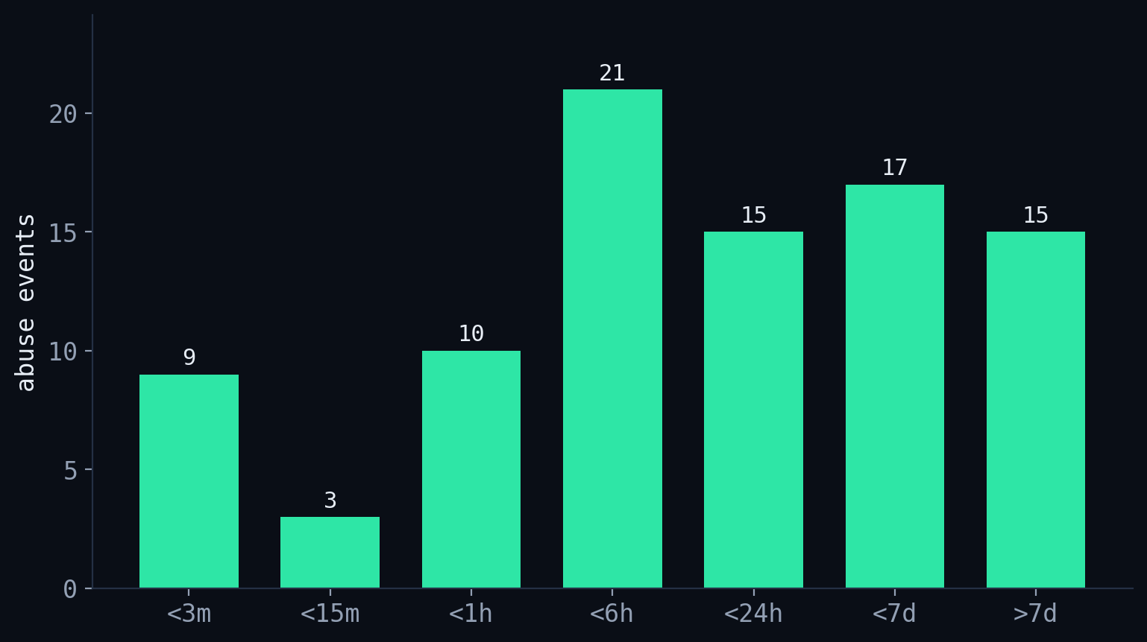
> GROUP BY time_to_abuse_bucket (N=90)
How fast? Bimodal — and the fast half is brutal.
74%
abused < 24h (of 53)
28%
abused < 1 hour
00:16
fastest of all
PhishTrack // Your credentials were leaked, so what?
Pass the Salt 2026 · TLP:CLEAR
20
Notes:
[SOLO] Question 2 answered. The distribution is BIMODAL — a real fast cluster (22 events under an hour) AND a long tail. Don't lead with the median (~6.8h); lead with the fast cluster and the 24h figure. Of the credentials that ever got abused, 74% were first abused within a day, 28% within the hour. Record 16 seconds. That's the answer: leaked isn't a future risk, it's present-tense.

Slide 22
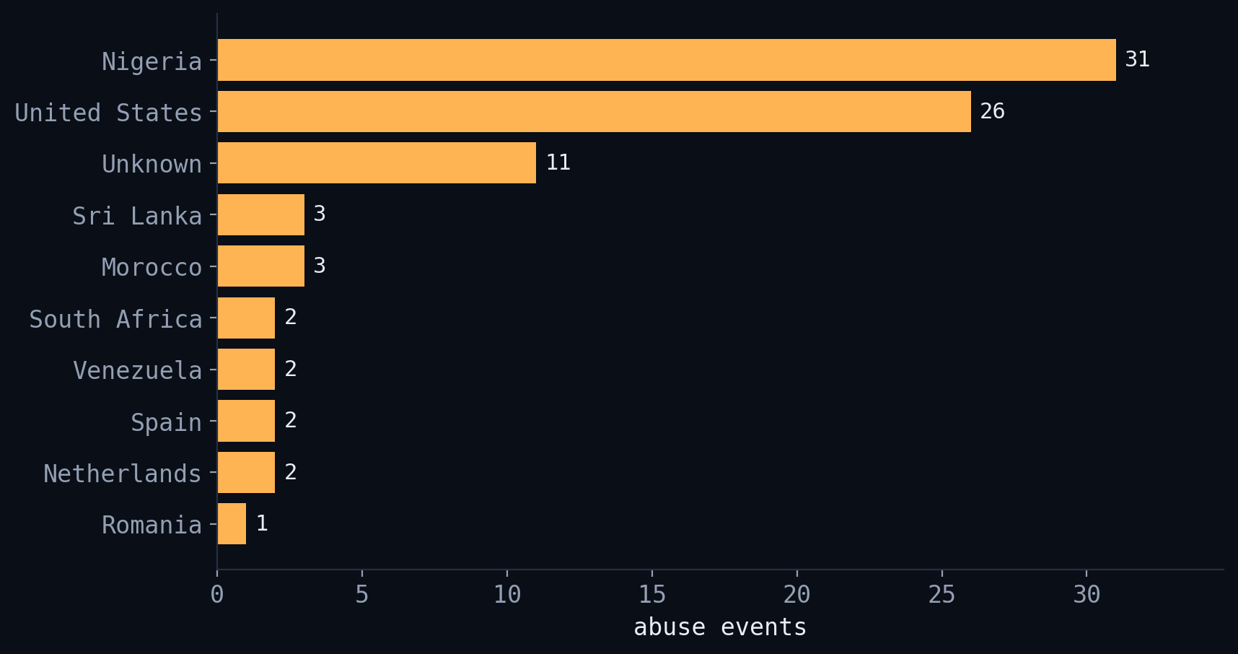
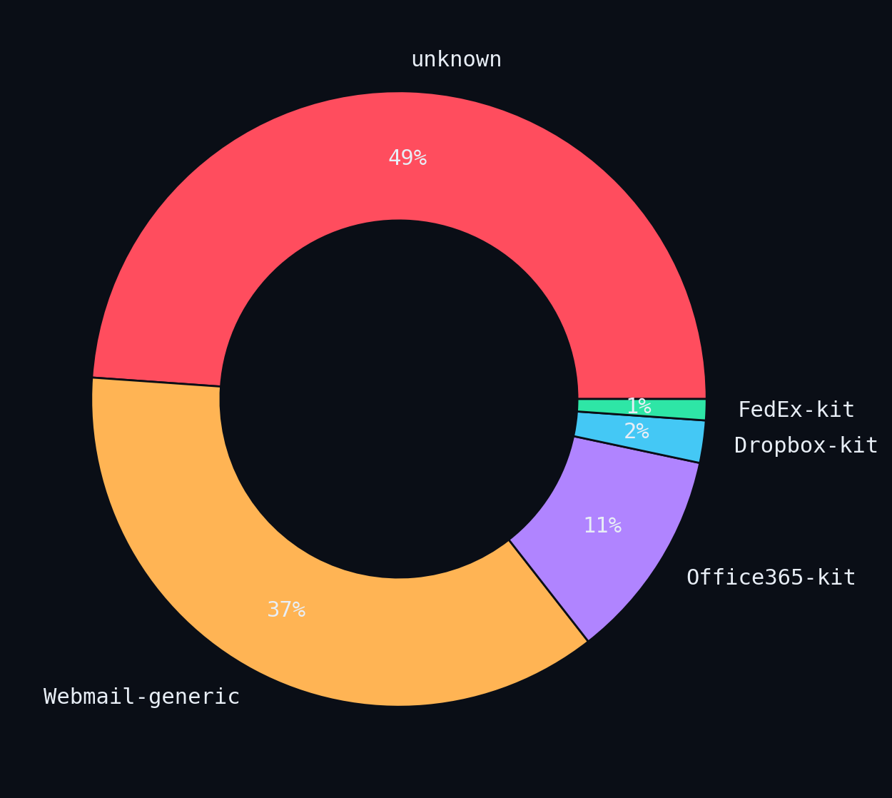
> GROUP BY country, kit_family (N=90)
From where, and who.
geography of abuse — volume
kits behind it
66.7%
VPN / datacenter
(33% residential · 0% Tor)
speed record ≠ volume leader:
Nigeria leads volume; Sri Lanka set the 16 s record.
no campaign attribution claimed — abused rows weren't campaign-tagged.
PhishTrack // Your credentials were leaked, so what?
Pass the Salt 2026 · TLP:CLEAR
21
Notes:
[SOLO] Question 3. Nigeria leads on VOLUME (31), then the US (26). The speed record, though, was Sri Lanka — 16 seconds. Two thirds came via VPN/datacenter IPs, one third residential, zero Tor. As for who: half the abuse traces to generic webmail kits; ~half is unattributed. We do NOT claim campaign attribution from this set — abused rows weren't campaign-tagged.

Slide 23
> the answer
So what?
74%
of stolen credentials that get used are
used within 24 hours. the fast ones: seconds.
assume reuse
MFA ≠ enough
steal the canary idea
leaked = already in use
AitM steals the session token
bait, don't just block
your credentials were leaked.
Now you know so what. — Questions ? https://github.com/teqagogo/phistrack/
PhishTrack // Your credentials were leaked, so what?
Pass the Salt 2026 · merci
22
Notes:
[SOLO] Close the loop. So what? THIS: of the stolen credentials that get used, nearly three-quarters are used within a day — and the fast ones in seconds. Three takeaways: assume reuse; MFA isn't enough (adversary-in-the-middle steals the session token); steal the canary idea. Repo + contact, credit Xavier @xme, open the floor (~7-9 min Q&A).

